Slide 1


Slide 2

Java OOP and Data Structures with Introduction to Secure Coding Dr. Ziping Liu
Chapter 22 Graph

Slide 3
https://he.kendallhunt.com/product/java-oop-and-data-structures-introduction-secure-coding
Chapter 22 Graph

Slide 4

Chapter Outlines
What is graph
Directed Graph ADT Representation
Graph Depth First Traversal
Graph Breadth First Traversal
Finding connected components and bipartite graph (available on the supplemental website)
Finding bridges and articulation points (available on the supplemental website)
Find cycle and topological numbering (available on the supplemental website)
Prim’s algorithm (available on the supplemental website)
Dijkstra’s algorithm (available on the supplemental website)

Slide 5
22.1 What Is Graph?
Concept of Graph
A graph G consists of a set of vertices (also called nodes) V and a collection of edges (also called links) E, where each edge connects two vertices.
A vertex represents a node in the graph, and an edge represents a link between two vertices.
A tree is a special type of graph that is acyclic and connected, meaning it allows exactly one path between any two nodes.
A general graph can have multiple paths between nodes and may also contain cycles, where a path starts and ends at the same vertex.

Slide 6
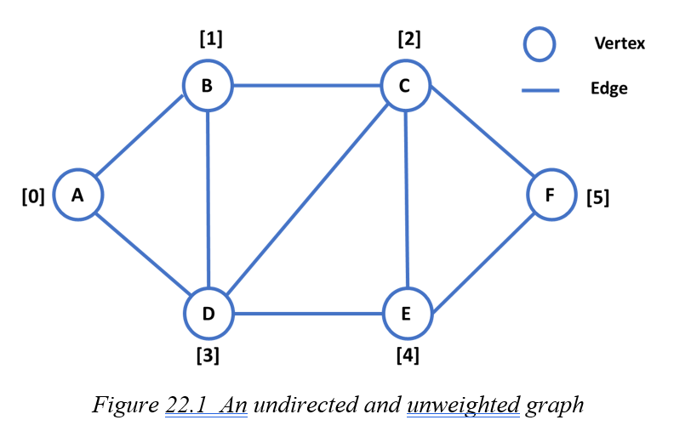
22.1 What Is Graph?
An undirected and unweighted graph
In Figure 22.1, a graph G = {V, E}, which represents a computer network topology where each vertex corresponds to a router, and each edge represents a communication link between two routers
the vertex set V = {A, B, C, D, E, F} represents the routers, and the edge set E = {{A, B}, {A, D}, {B, D}, {B, C}, {D, C}, {D, E}, {C, E}, {C, F}, {E, F}} represents the communication links between them.

Slide 7
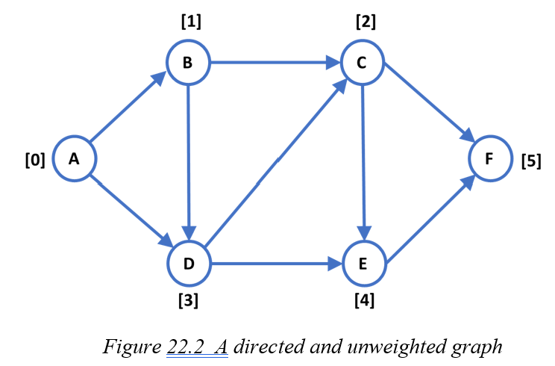
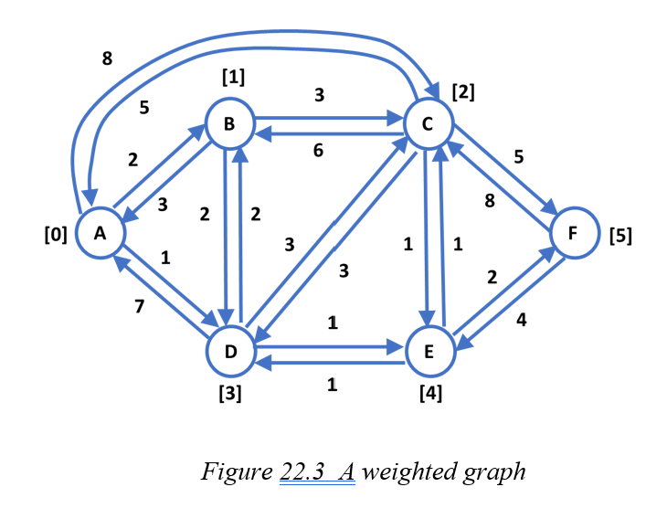
22.1 What Is Graph?
A directed and unweighted graph
A weighted graph

Slide 8
22.1 What Is Graph?
Terminology
Relationship between two vertices:
Adjacent: Two vertices are adjacent if there is an edge connecting them. For example, vertices A and B are adjacent if there is an edge AB.
Predecessor: In a directed graph, the starting vertex of a directed edge is called the predecessor of the ending vertex. For instance, A is the predecessor of B in the edge AB.
Successor: In a directed graph, the ending vertex of a directed edge is called the successor of the starting vertex. For instance, B is the successor of A in the edge AB.

Slide 9
22.1 What Is Graph?
Terminology
Visiting vertices:
Path: A sequence of edges that connects a series of vertices, where no edge is repeated. For example, the path A->F consists of edges AB, BD, DE and EF.
Acyclic path: A path in which no vertex is visited more than once and no edge is repeated. For instance, the path A->F consists of edges AB, BD, DE and EF.
Cyclic path: A path that includes at least one vertex visited more than once, while still ensuring no edge is repeated. For example, the path A->A via edges AB, BD, and DA.

Slide 10
22.1 What Is Graph?
Terminology
Special graphs:
Acyclic Graph: A graph that contains no cyclic paths.
Complete Graph: An undirected graph in which every pair of vertices is connected by a unique edge.
Connected Graph: An undirected graph in which there is a path between every pair of vertices.
Tree: A connected, undirected graph with no cycles (acyclic).
Subgraph: A graph consisting of a subset of the edges and vertices of another graph.

Slide 11
22.1 What Is Graph?
Graph Applications
Computer Networks: In a computer network, each vertex represents a device such as a computer or a switch, and each edge represents a communication link between devices.
Airline and Transportation Networks: In an airline network, cities are vertices, and flights between cities are edges. Similarly, in a transportation network, locations are vertices, and roads connecting them are edges.
Social Networks: In a social network, vertices represent people, and edges represent relationships, such as friendships or connections, between individuals.
Web Structure: The relationships between websites can be modeled as a graph, where each vertex represents a website, and each edge represents a hyperlink from one website to another.
Project Management: Graphs can represent task dependencies in project management. Here, vertices represent tasks, and directed edges indicate dependencies, showing which tasks must be completed before others can begin.

Slide 12
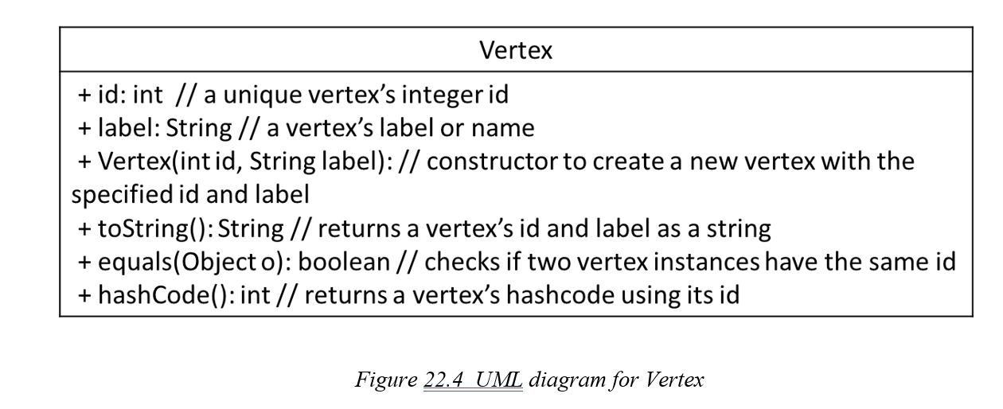
22.2 Directed Graph ADT Representation

Slide 13
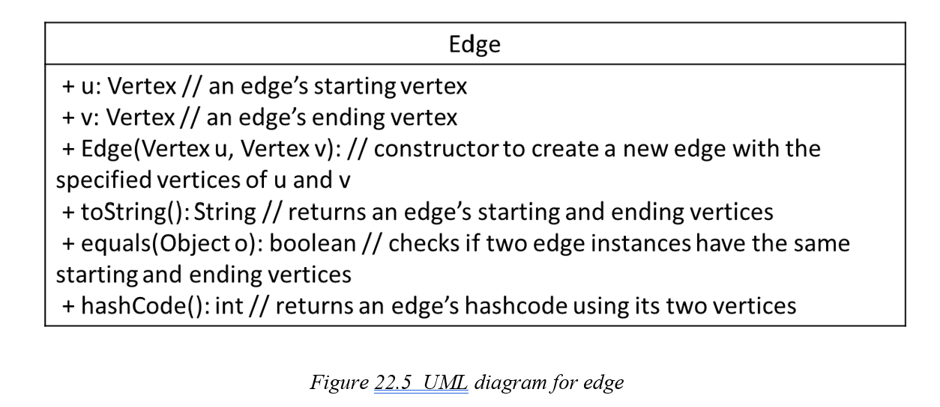
22.2 Directed Graph ADT Representation

Slide 14
22.2 Directed Graph ADT Representation
Keep track of all edges originating from a specific vertex: use a list to store its neighboring edges - edge adjacency list.
Vertices: Edge adjacency lists
A: Edge(A, B) -> Edge(A, D)
B: Edge(B, C) -> Edge(B, D)
C: Edge(C, E) -> Edge(C, F)
D: Edge(D, C) -> Edge(D, E)
E: Edge(E, F)

Slide 15
22.2 Directed Graph ADT Representation
A graph can also be represented using an adjacency matrix, where all vertices are listed as both rows and columns.
Int[][] adjMatrix = {
//A, B, C, D, E, F
{0, 1, 0, 1, 0, 0}, // A
{0, 0, 1, 1, 0, 0}, // B
{0, 0, 0, 0, 1, 1}, // C
{0, 0, 1, 0, 1, 0}, // D
{0, 0, 0, 0, 0, 1}, // E
{0, 0, 0, 0, 0, 0} }; // F

Slide 16
22.2 Directed Graph ADT Representation
Representing a graph using an adjacency matrix is often inefficient due to the sparsity of the matrix. Instead of using a matrix, we can use lists to represent the relationships among vertices, a method known as vertex adjacency lists.
Vertices: Vertex adjacency lists
A: B -> D
B: C -> D
C: E -> F
D: C -> E
E: F

Slide 17
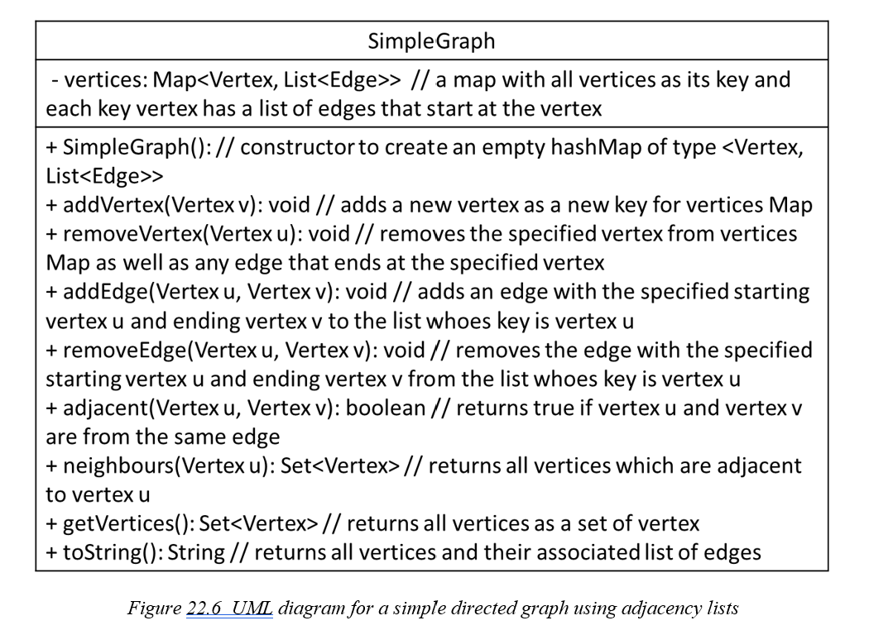
22.2 Directed Graph ADT Representation
SimpleGraph

Slide 18
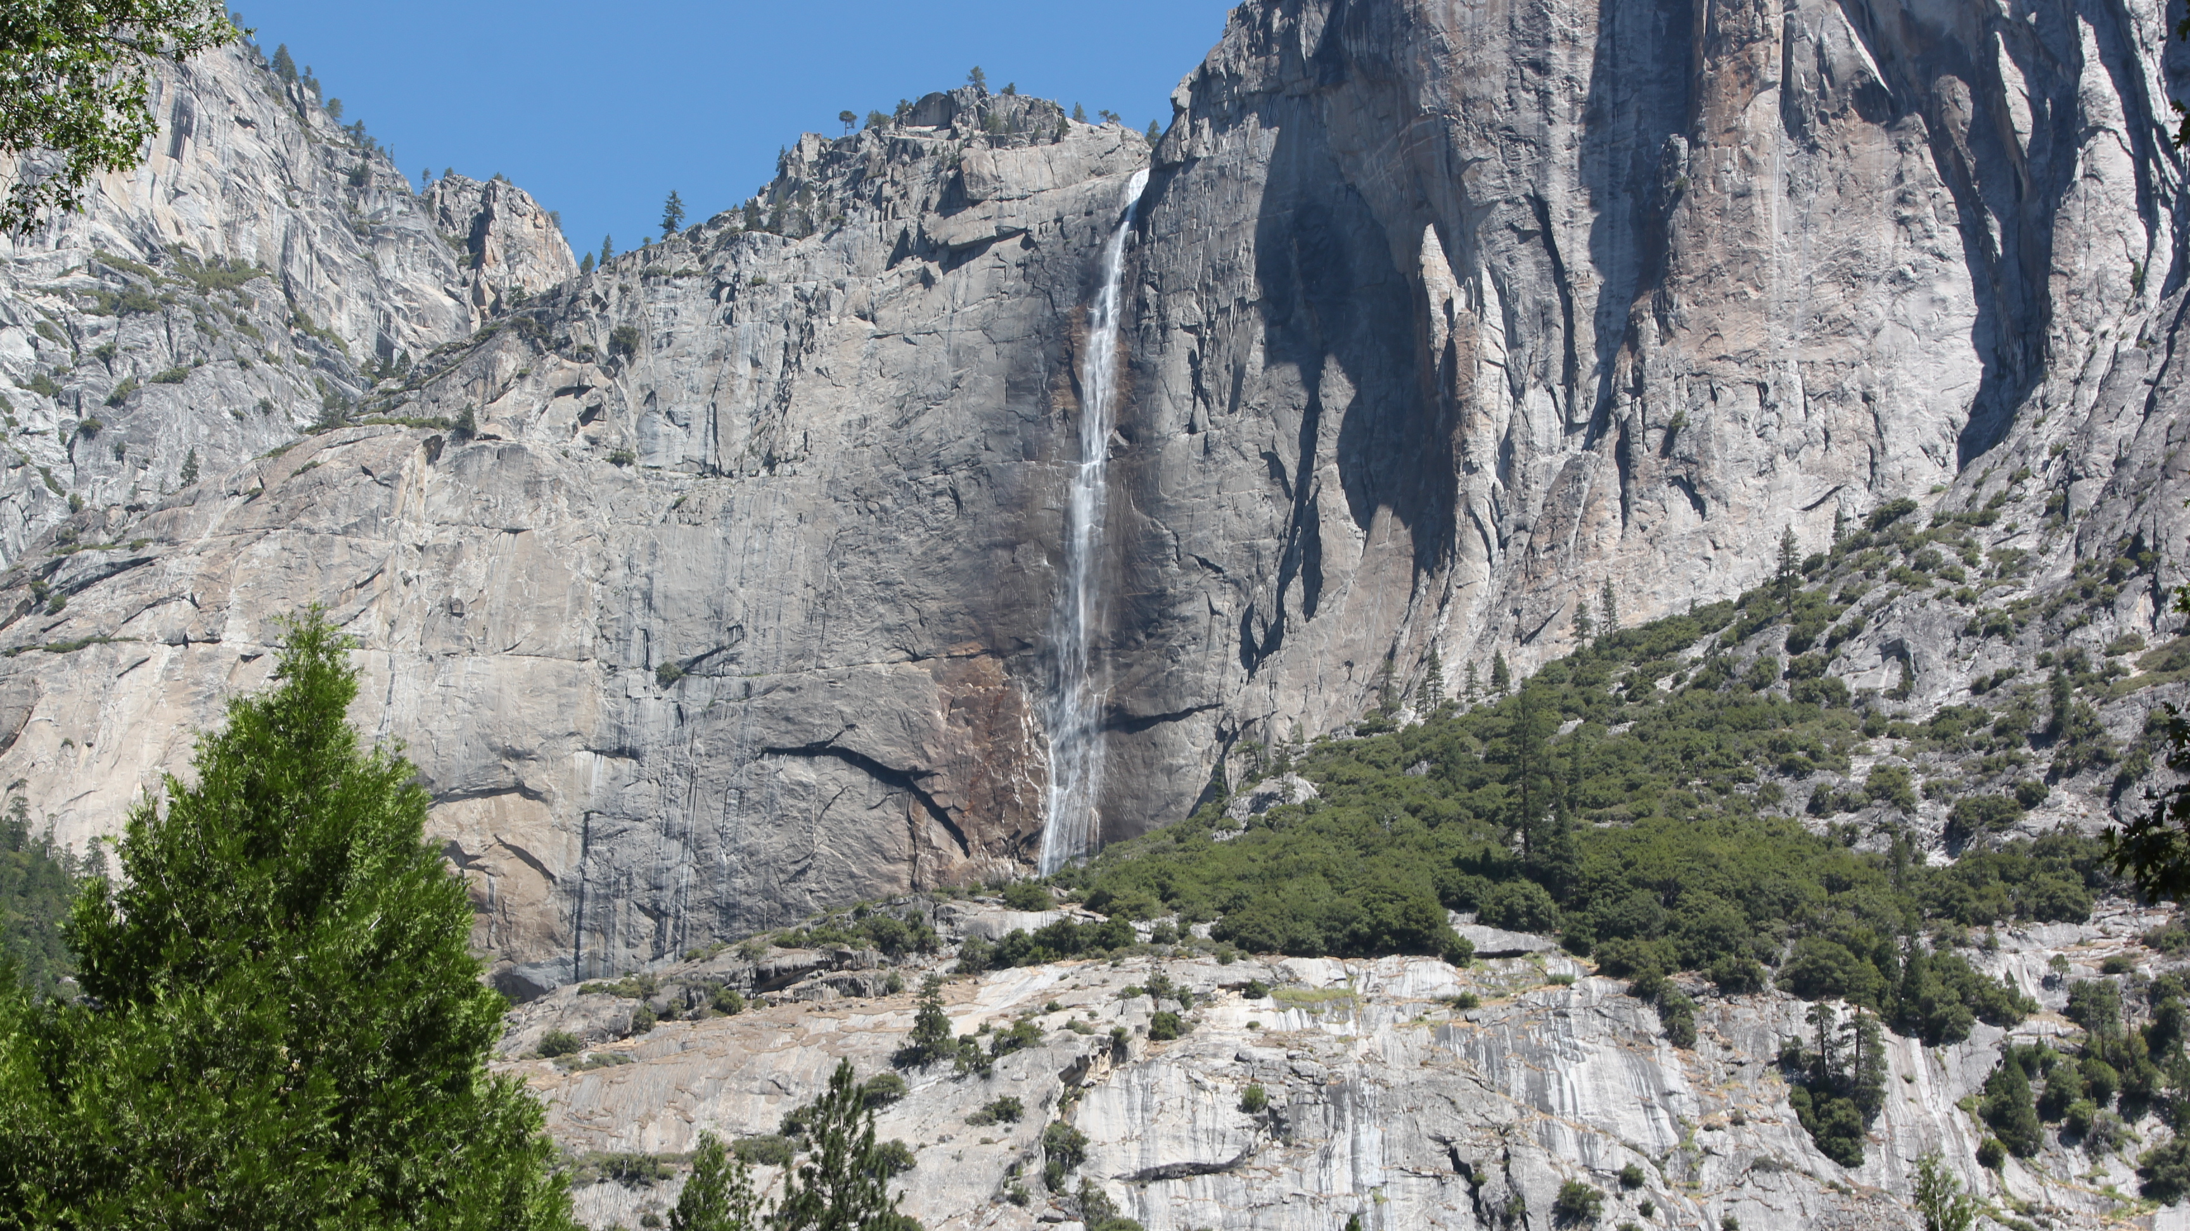

Slide 19
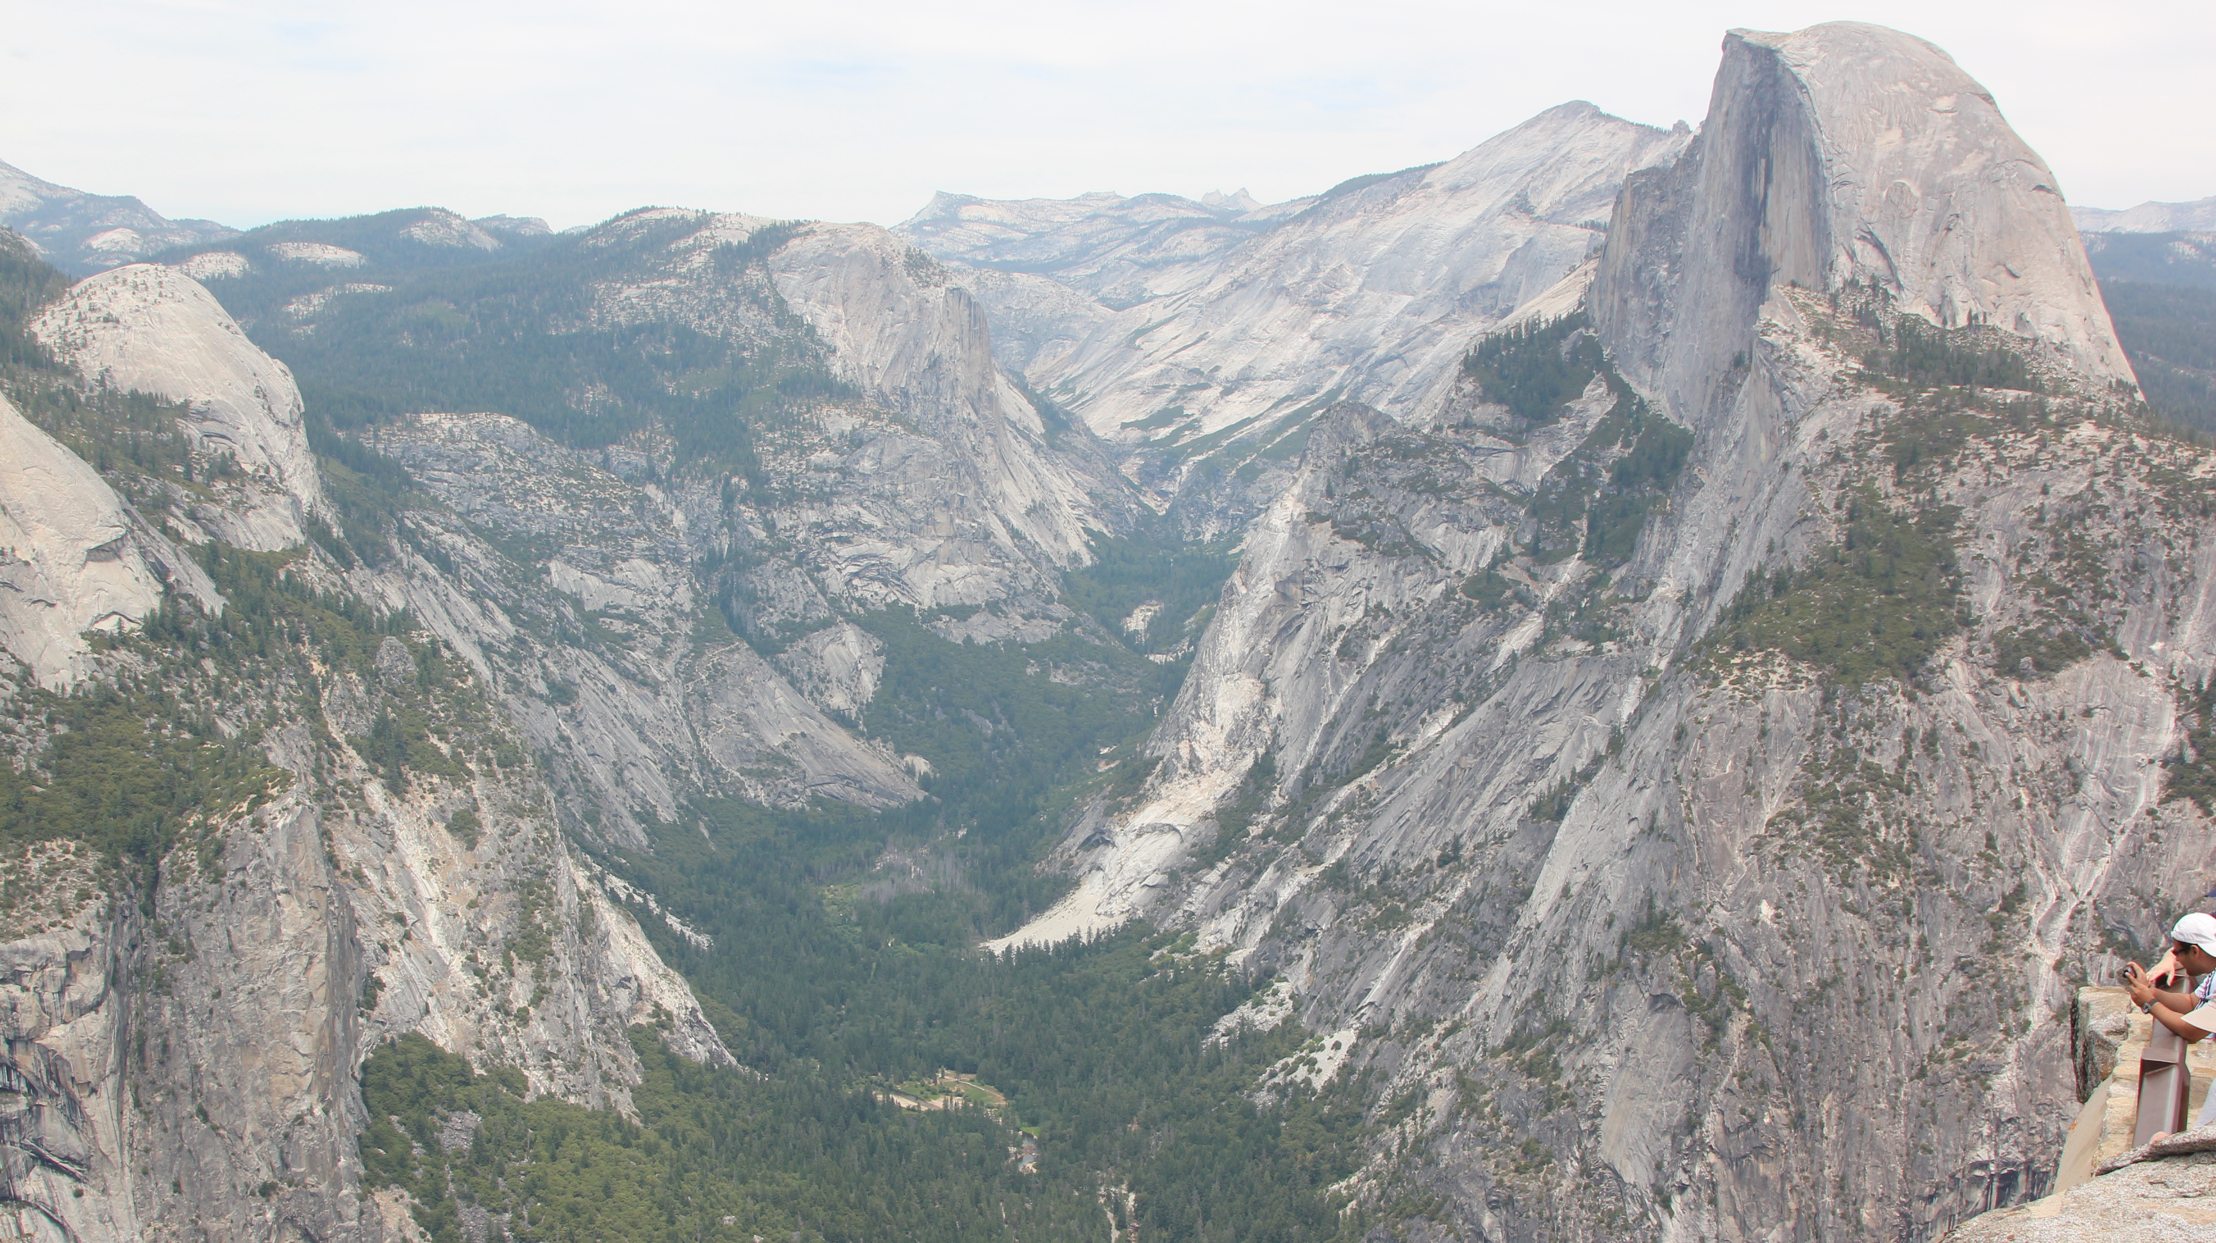

Slide 20
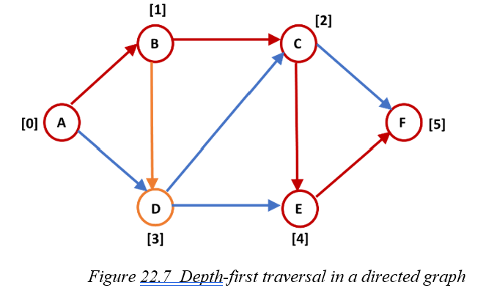
22.3 Graph Depth First Traversal
Definition of Depth First Traversal
starting from a given vertex—referred to as the origin—we move downward by following each unvisited successor vertex as far as possible until no unvisited successor vertices remain. At this point, we backtrack to explore other unvisited paths.
A successor vertex is defined as the ending vertex of an edge originating from a specified starting vertex.

Slide 21
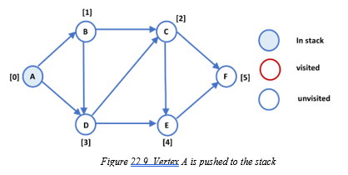
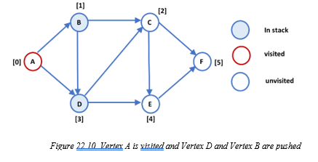
22.3 Graph Depth First Traversal
Depth First Traversal Using Stack

Slide 22
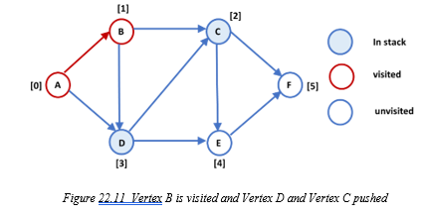
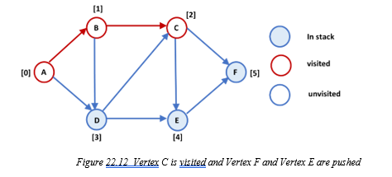
22.3 Graph Depth First Traversal
Depth First Traversal Using Stack

Slide 23
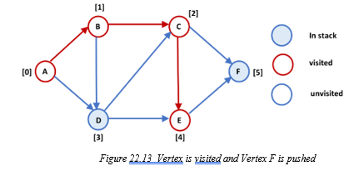
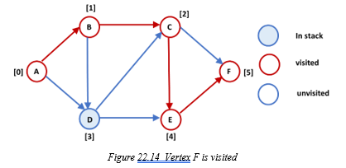
22.3 Graph Depth First Traversal
Depth First Traversal Using Stack

Slide 24
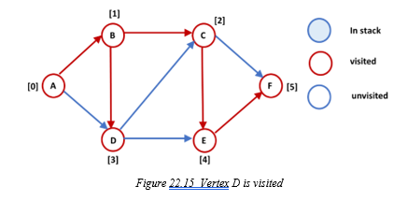
22.3 Graph Depth First Traversal
Depth First Traversal Using Stack
Depth First Traversal can also use recursive approach
depth-first search (DFS) on a graph G with V vertices and E edges, when G is represented using edge adjacency lists, the time complexity for DFS is O(V+E).
If a graph has a large number of edges, which occurs when most vertices have pairs of connected edges, then E ~= V × V and the time complexity becomes O(V^2).
When G is represented using an adjacency matrix, time complexity is O(V^2).

Slide 25
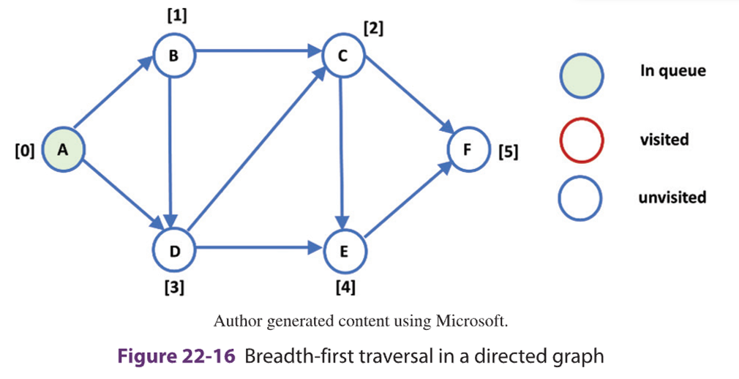
22.4 Graph Breadth First Traversal
Definition of Breadth First Traversal
begins at a vertex and visits all vertices that are one edge away from the source vertex before proceeding to vertices that are two edges away, and so on.
each iteration focuses on visiting all unvisited vertices that are equidistant from the source vertex.

Slide 26
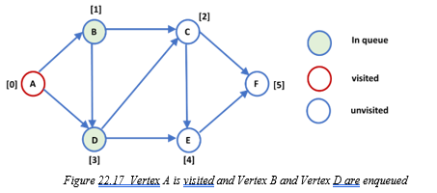
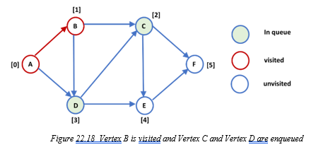
22.4 Graph Breadth First Traversal
Breadth First Traversal Using Queue

Slide 27
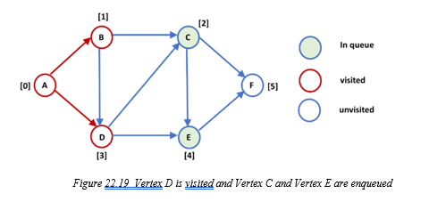
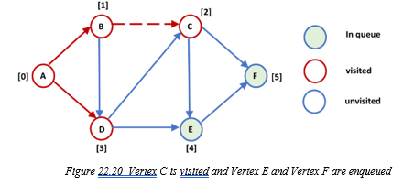
22.4 Graph Breadth First Traversal
Breadth First Traversal Using Queue

Slide 28
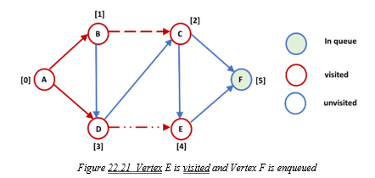
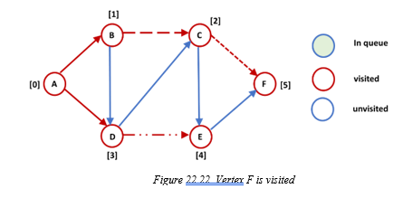
22.4 Graph Breadth First Traversal
Breadth First Traversal Using Queue

Slide 29
22.4 Graph Breadth First Traversal
Breadth-first search on a graph G with V vertices and E edges, when G is represented using edge adjacency lists, the time complexity for breadth-first search is O(V + E).
If a graph has a large number of edges, which occurs when there exist multiple edges between a pair of vertices for most vertices, then E ~= V × V, and the time complexity is O(V^2).
When G is represented using an adjacency matrix, the time complexity is O(V^2).

Slide 30
22.4 Graph Breadth First Traversal
Depth First Search vs Breadth First Traversal
BFS can be used to find the shortest path between two vertices in a graph if the weights of the edges are the same, while DFS may not guarantee finding the shortest path.
When considering the distance between a searched vertex and a source vertex, if the searched vertex is not farther away, BFS is preferable. If the searched vertex is farther, DFS is preferable. However, if the searching distance is too deep, it is best to restrict the depth for DFS.
In cases where the branching factor of vertices is very large, BFS may become undesirable since it may run out of memory to store all vertices to be explored next.

Slide 31
22.5 Undirected Graph ADT Representation
For an undirected graph, a vertex adjacency list can be used to track relationships between vertices instead of an edge adjacency list.
Vertices: Vertex adjacency lists
A: B -> D
B: A -> C -> D
C: B -> E -> F
D: B -> C -> E
E: C -> D -> F
F: C -> E

Slide 32
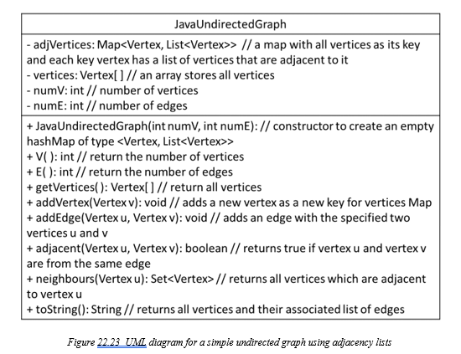
22.5 Undirected Graph ADT Representation

Slide 33
Which National Park is it?
Answer: Yosemite National Park

